Slide 1

CAPSTONE PROJECT - 4 Netflix Movies & TV Shows Clustering
COHORT - OSLO
TEAM MEMBER:
ANUP A. JAMBULKAR
VIBHU SHARMA
GAURAV MALAKAR
ANKIT WALDE
ANIL BHATT

Slide 2

Contents:
Introduction.
Dataset Preview.
Exploratory Data Analysis.
Data Preprocessing.
Creating Clusters.
Conclusions.

Slide 3

Introduction:
Netﬂix is a media distribution company. It started with DVD distribution via mail, but has evolved substantially over the course of its existence. Today, Netﬂix is focused on streaming video. Some of its content is licensed, and some of the content is produced in-house.
Netﬂix originally focused on movies, but today television shows are probably the more common format. Netﬂix works on a subscription model, where users get unlimited access to content with a paid subscription.

Slide 4
Dataset Preview:
This dataset consists of tv shows and movies available on Netﬂix as of 2019. The dataset is collected from Flixable which is a third-party Netﬂix search engine.
Attribute Information
show_id : Unique ID for every Movie / Tv Show
type : Identiﬁer - A Movie or TV Show
title : Title of the Movie / Tv Show
director : Director of the Movie
cast : Actors involved in the movie / show
country : Country where the movie / show was produced
date_added : Date it was added on Netﬂix
release_year : Actual Release Year of the movie / show
rating : TV Rating of the movie / show
duration : Total Duration - in minutes or number of seasons
listed_in : Genre
description: The Summary description

Slide 5
Dataset summary:
The dataset contains 12 columns and 7787 rows.
There also exist some null values in our data: Percentage of null values in director: 30.68%
Percentage of null values in cast : 9.22% Percentage of null values in country : 6.51% Percentage of null values in date_added : 0.13% Percentage of null values in rating : 0.089%
Since there are null values in the above variables we will replace them with 0.
Finally, we will do some feature engineering to create few new variables:
Compute year_added, month_added and day_added from date_added after converting it into a datetime variable.

Slide 6
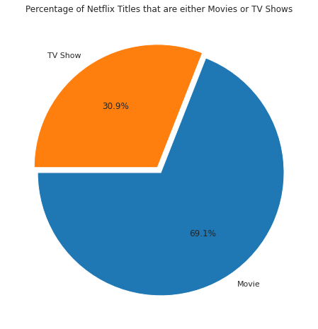
Exploratory Data Analysis:
Type:
69.1% of the content available on Netﬂix are movies; the remaining 30.9% are TV Shows.

Slide 7
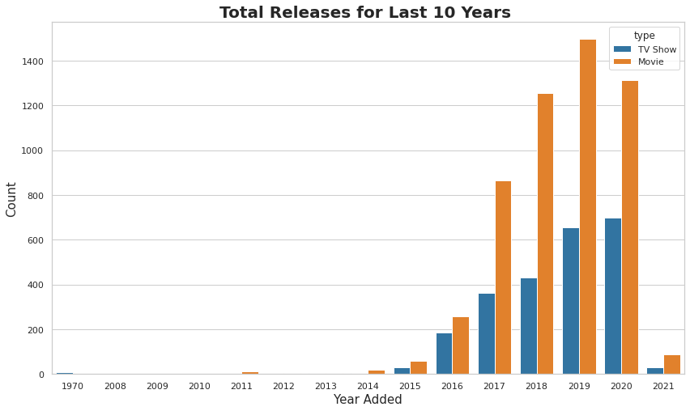
Year_added:
Growth in the number of movies on Netﬂix is much higher than tv shows.
From 2015 we can see a noticeable addition in the number of movies and tv shows uploaded by Netﬂix on its platform.
The highest number of movies and tv shows got added in 2019 and 2020.
The line plot shows very few movies, and tv shows got added in 2021. It is due to very little data collected from the year 2021.

Slide 8
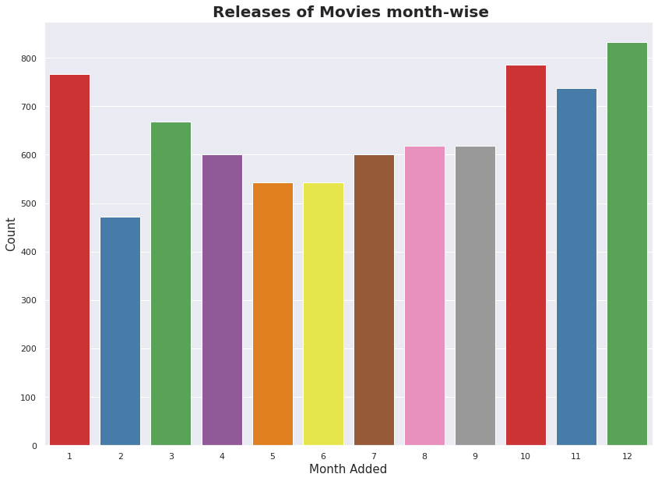
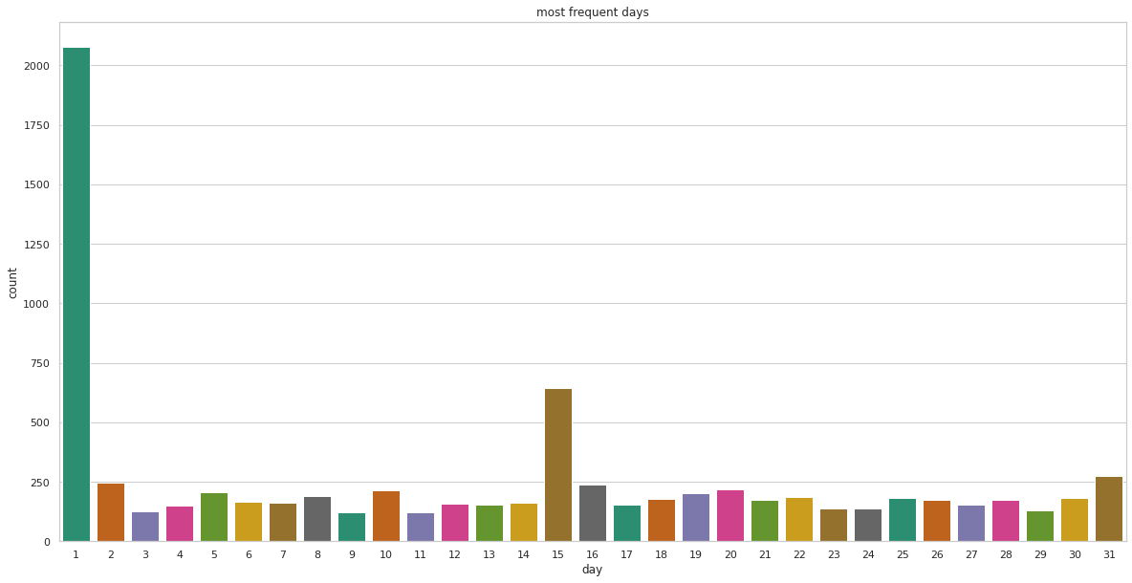
Month_added and Day_added:
Most of the content is uploaded either by year ending or beginning.
October, November, December, and January are months in which many shows and movies get uploaded to the platform.
It might be due to the winter, as in these months people may stay at home and watch shows and movies in their free time.
Most of the content is uploaded at the beginning, middle, or the end of a month.
Which makes 1st, 15th or 31st of a month more prominent in getting new tv shows and movies.

Slide 9
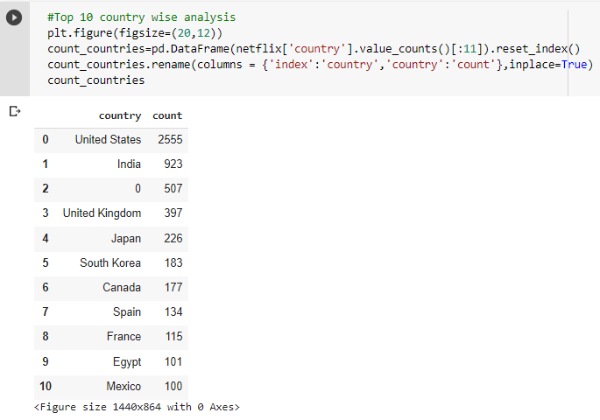
Country:
The majority of the content providers are in the above top-ten countries.
Among which USA, India, and Uk create more than half of the tv shows and movies on the platform.

Slide 10
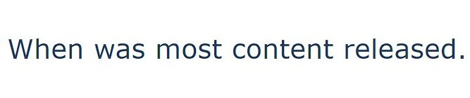
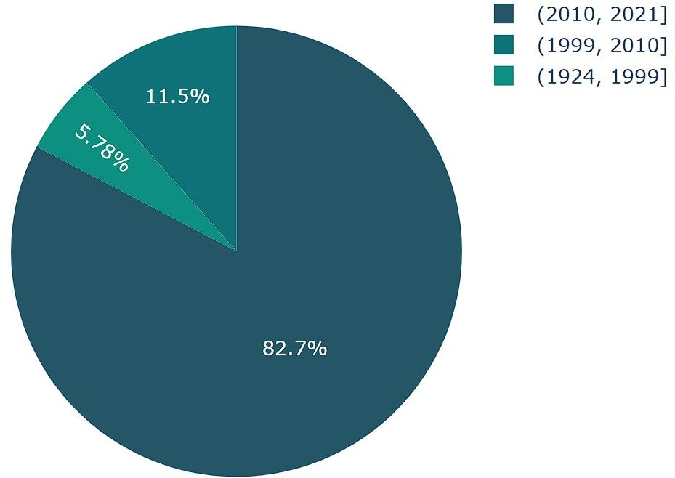
Release_year:
82% of the content available was released between 2010 and 2021.
17.28% of the content available was released before 2010.

Slide 11
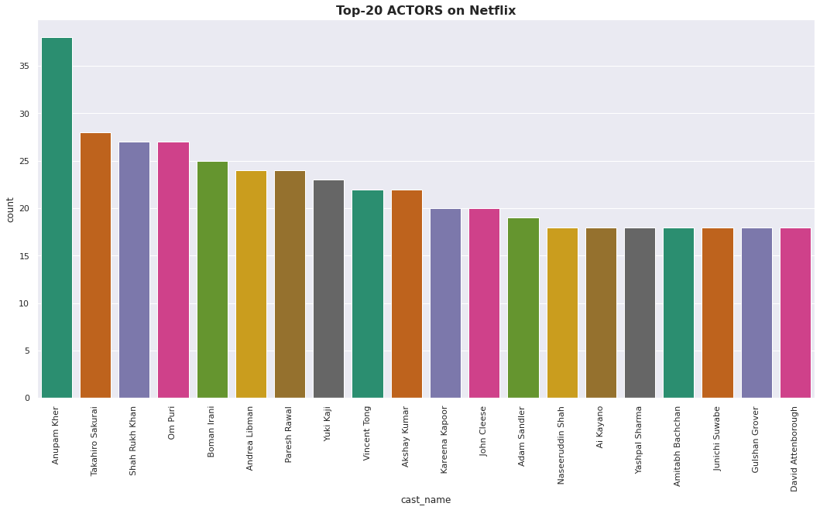
Cast:
Six of the actors in the top ten list with most numbers tv shows and movies are from India.
With Anupam Kher at the top with 38 tv shows and movies in total.

Slide 12
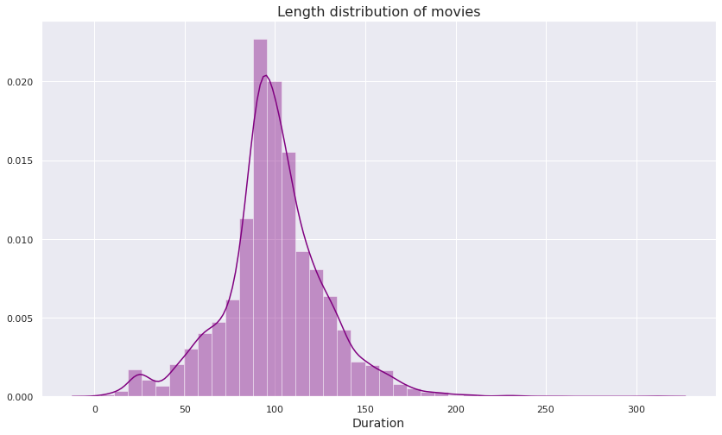
Duration:
Most of the movies last for 90 to 120 minutes.

Slide 13
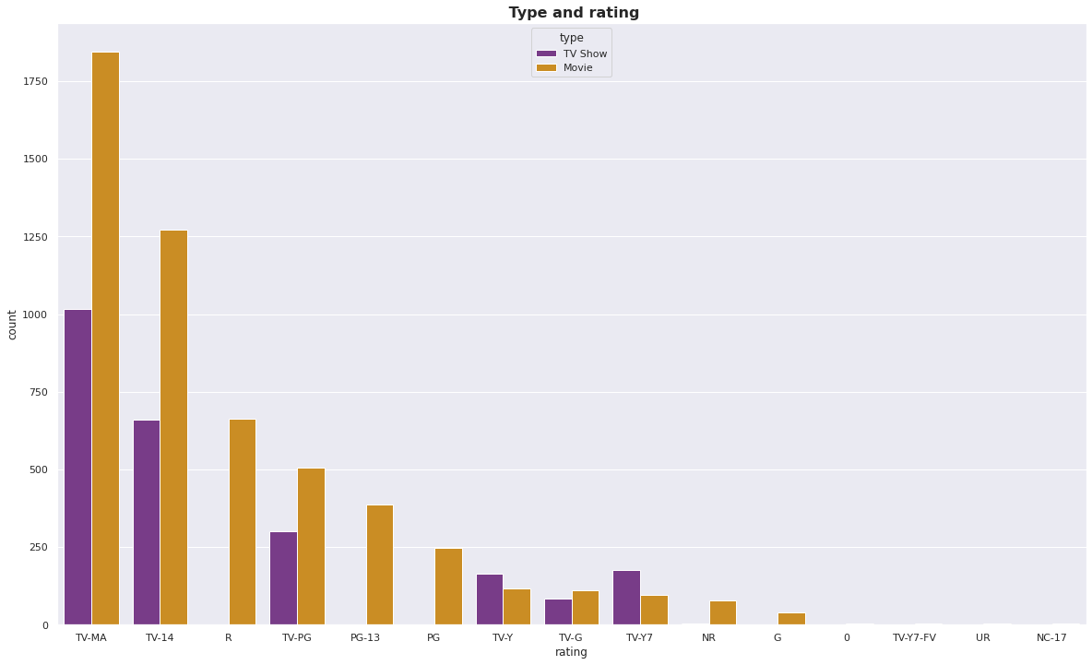
Ratings:
TV-MA tops the charts, indicating that mature content is more popular on Netﬂix.
This popularity is followed by TV-14 and TV-PG, which are Shows focused on Teens and Older kids.
Very few titles with a rating NC-17 exist. It can be understood since this type of content is purely for the audience above 17.

Slide 14
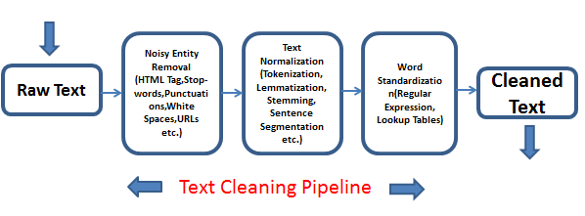
Data Preprocessing.

Slide 15
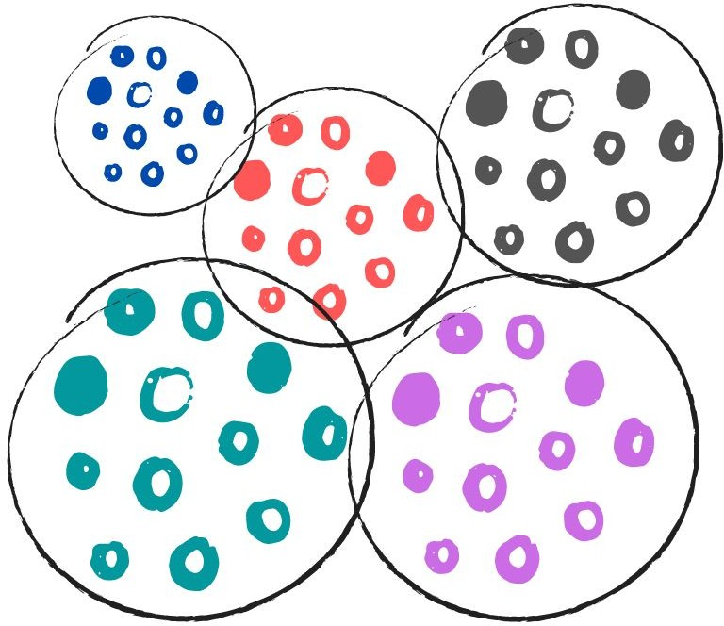
Creating Clusters:
What is clustering?
Clustering is the task of dividing the data points into a number of groups such that data points in the same groups are more similar to other data points in the same group and dissimilar to the data points in other groups. It is basically a collection of objects on the basis of similarity and dissimilarity between them.
How to cluster similar data?
To create clusters we will use the K-Means Clustering; which is an iterative process in which the dataset is grouped into k number of predeﬁned non-overlapping clusters or subgroups, making the inner points of the cluster as similar as possible while trying to keep the clusters at distinct space it allocates the data points to a cluster so that the sum of the squared distance between the clusters centroid and the data point is at a minimum.

Slide 16
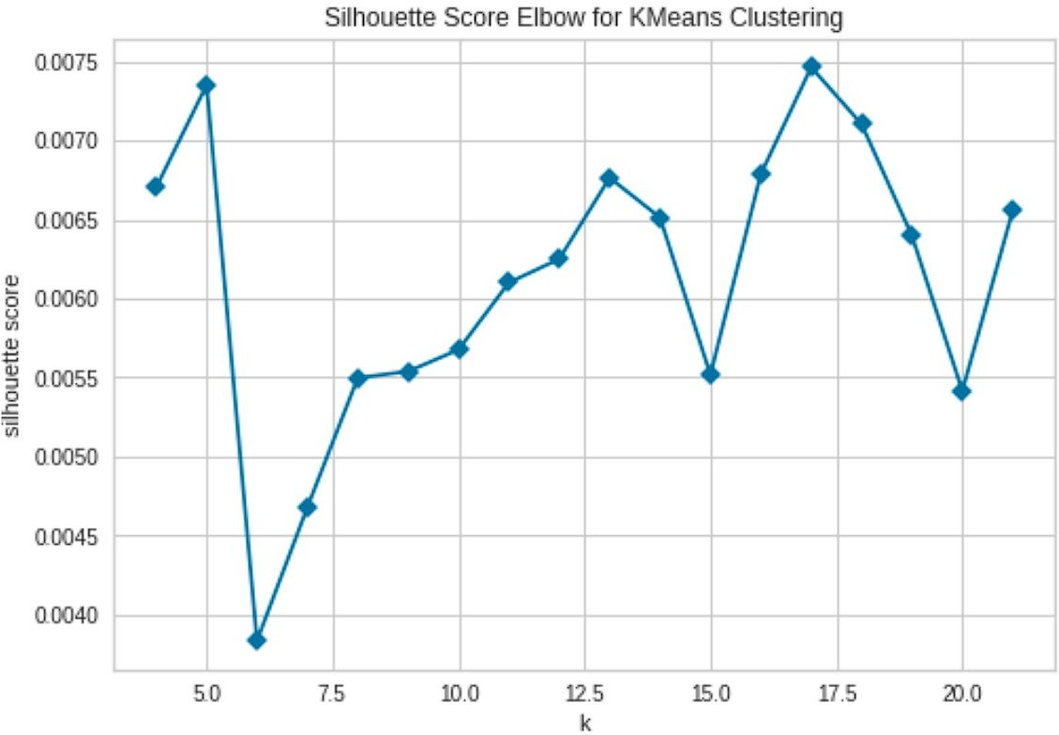
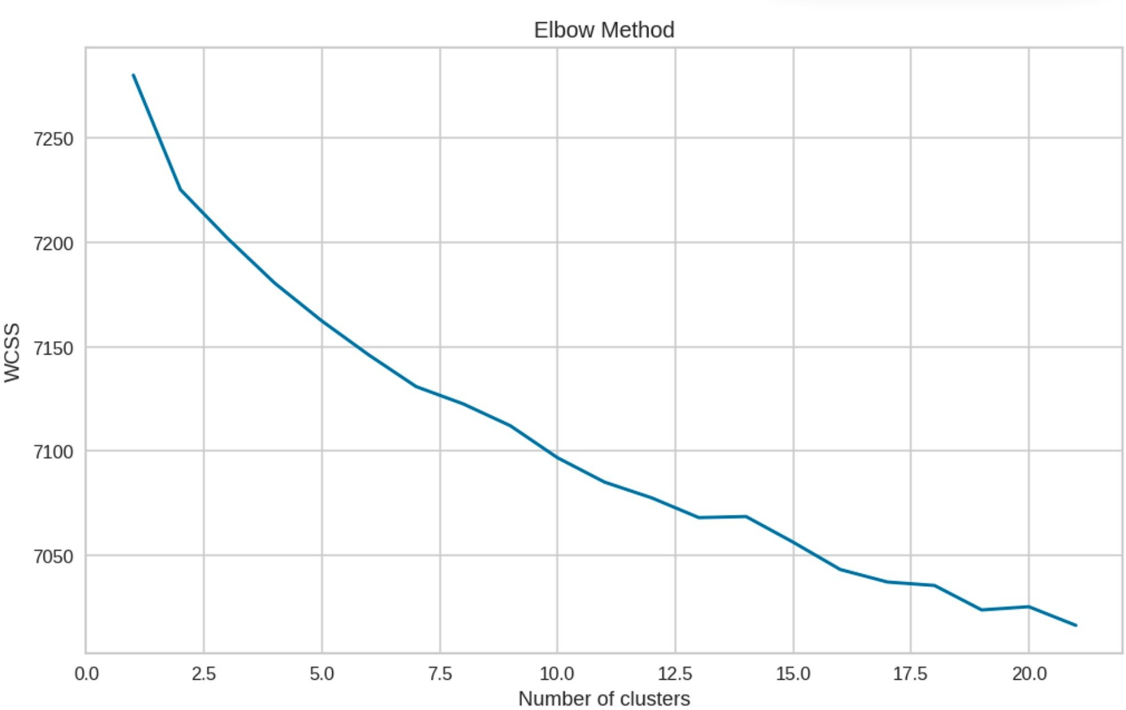
Determining optimal value for k:
Using the Silhouette Score and Elbow Method we select the optimal number of clusters to be 10.

Slide 17
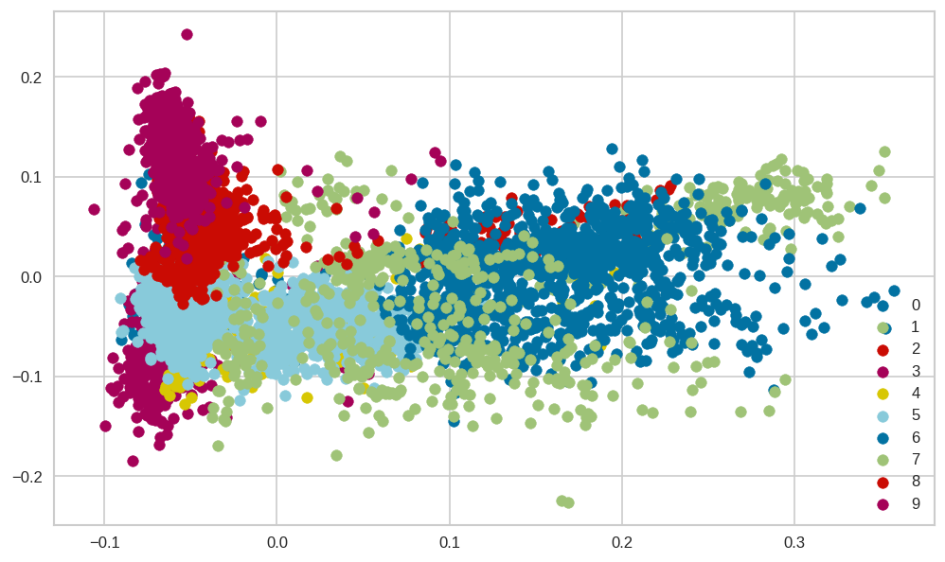
10 Distinct clusters created using kMeans Clustering
The numbers 0 to 9 represent 10-distinct clusters formed by K-means clustering.
Each cluster contains data points similar to those in the same groups but varies from other groups.

Slide 18
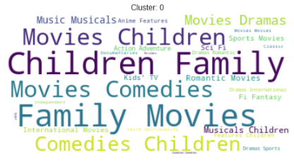
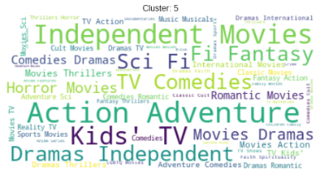
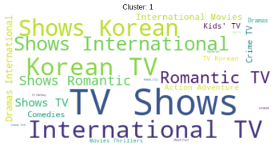
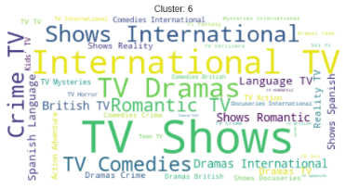
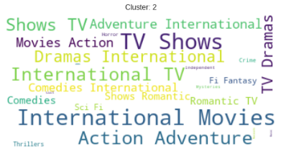
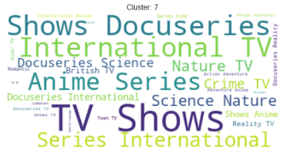
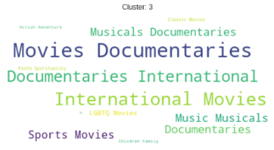
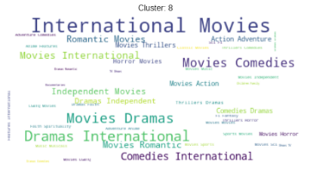
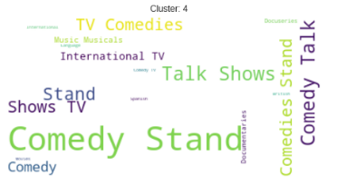
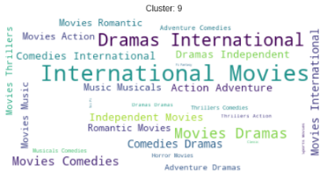
Data represented by each cluster:
Cluster 0:Family and Children Movies.
Cluster 1: Korean and Romantic Tv Shows.
Cluster 2: International Movies and Tv Shows.
Cluster 3: Musical Movies and Documentaries.
Cluster 4: Stand Up Comedy and Comedy Shows.
Cluster 5: Action, Adventure, and Independent Movies.
Cluster 6: Science, Nature, Reality.
Cluster 7: Crime Tv Shows and Docuseries, Anime Series.
Cluster 8: International Comedy Shows.
Cluster 9:International Tv Shows.

Slide 19
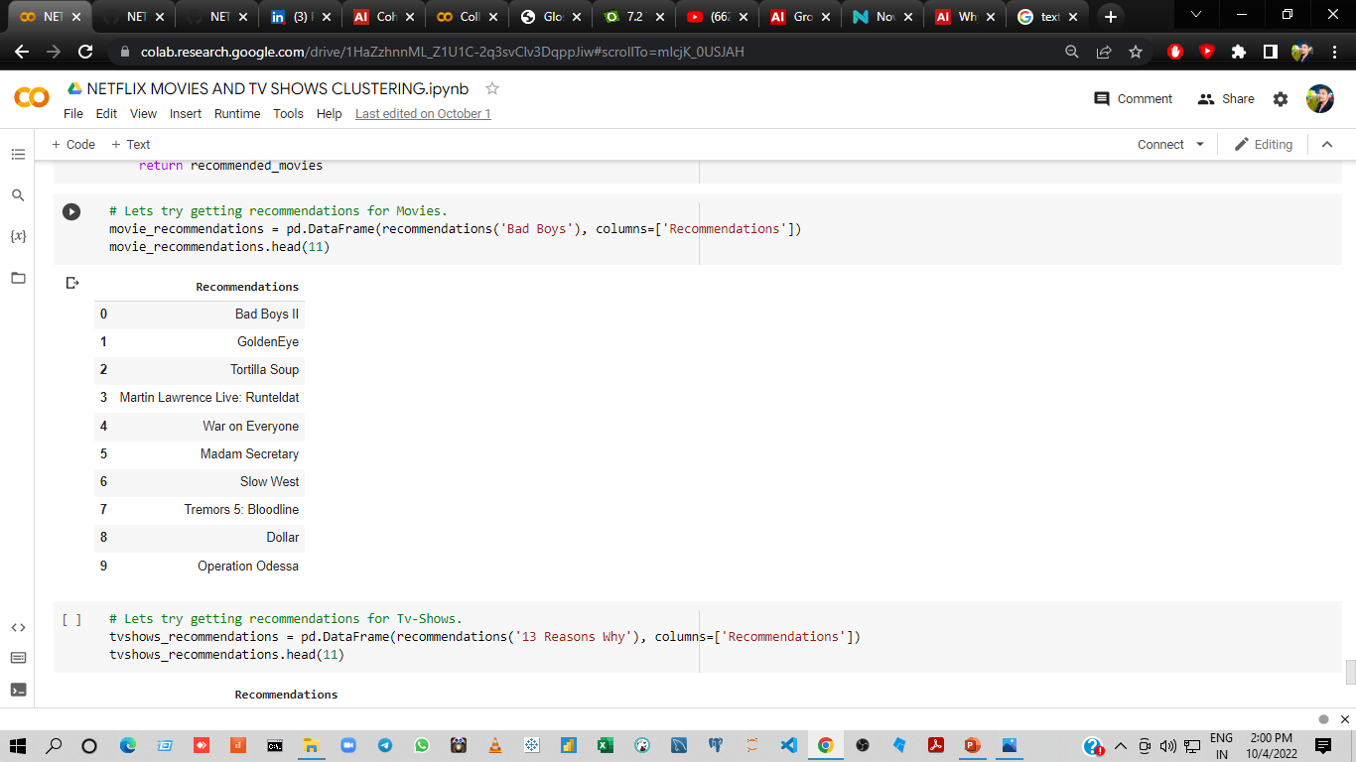
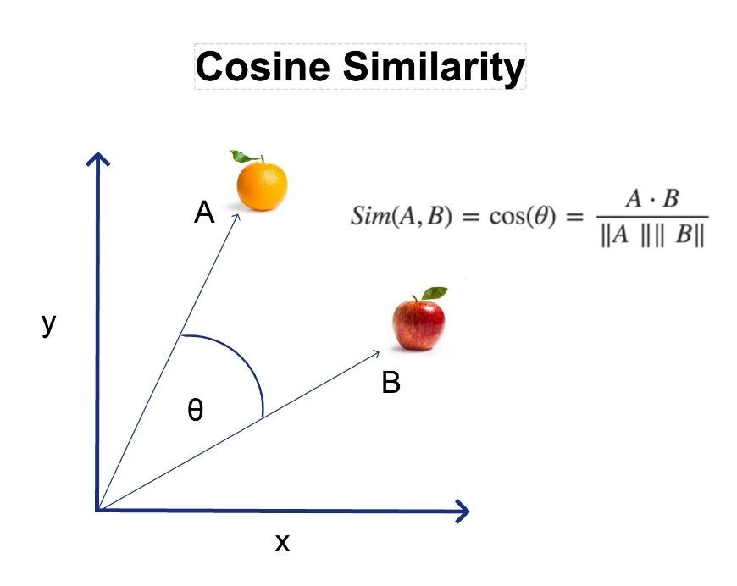
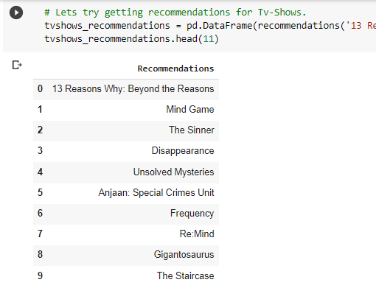
Getting Recommendations:
We obtained recommendations for Movies and Tv- Shows using Cosine similarity.

Slide 20
Conclusions:
It was interesting to ﬁnd that majority of the content available on Netﬂix is Movies.
But in the recent years it has been focusing more on Tv-Shows.
Most of these contents are released either in the year ending or the beginning.
United States and India are among the top 5 countries that produce all of the available content on the platform.
Also 6 of the actors among the top ten actors with maximum content are from India.
TV-MA tops the charts, indicating that mature content is more popular on Netﬂix.
k=10 was found to be an optimal value for clusters using which we grouped our data into 10 distinct clusters.
Using the given data a simple recommender system was created using cosine_similarity and recommendations for Movies and Tv Shows were obtained..

Slide 21


Future Scope:
Integrating this dataset with other external datasets such as IMDB ratings, rotten tomatoes can also provide many interesting ﬁndings.
More time could be given into building a better recommender system, which later can be deployed on web for usage.

Slide 22



